Slide 1



RGM-LLC Go Fund You
Ronnie Joubert Ryan Kuan Zach amerman
Ronnie

Slide 2
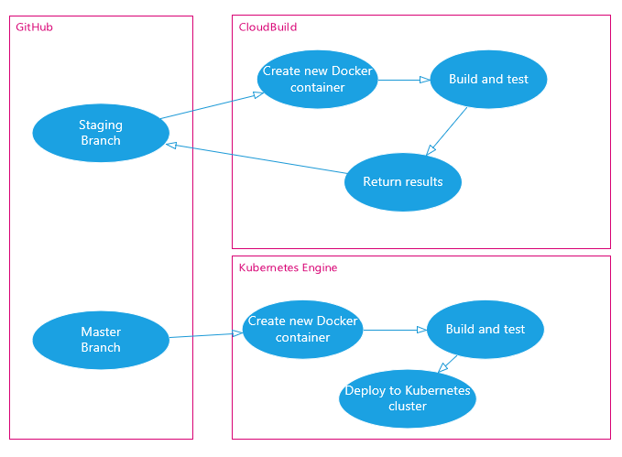
Build Process
Continuous Integration from Staging Branch
Continuous Deployment from Master Branch
Ronnie

Slide 3
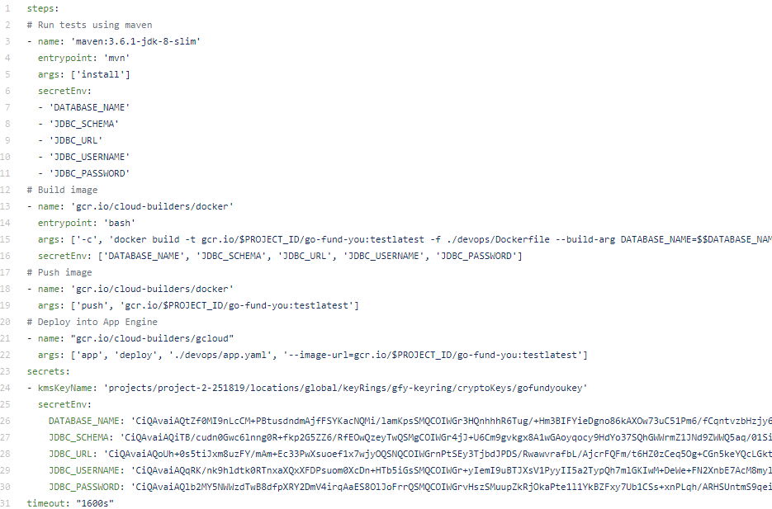
Cloud build
Ryan

Slide 4
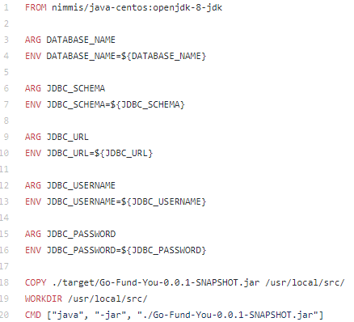
Dockerfile
Ryan

Slide 5
Continuous Deployment
Created a Compute Engine instance
Increased size of instance
Used instance to build Docker images
Triggered by Jenkins pipeline on merge to master branch
Ronnie

Slide 6
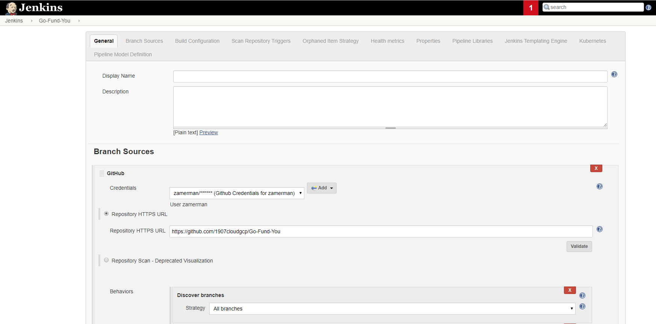
Jenkins
Zach

Slide 7
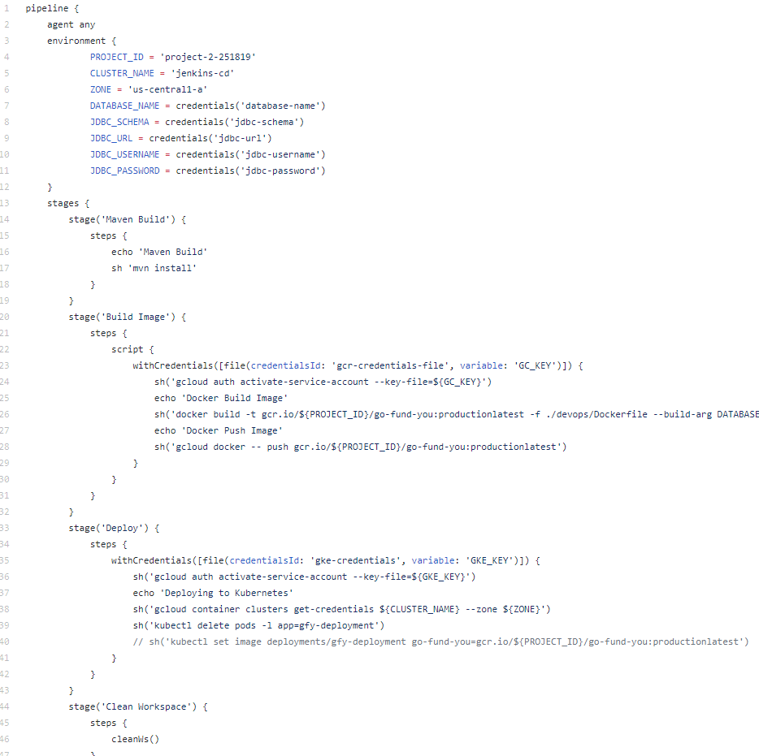
Jenkinsfile
Zach

Slide 8
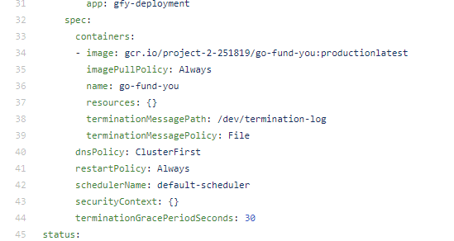
Deployment.yaml
Zach

Slide 9
Disaster recovery
Created a Jenkins instance in us-east-1
Backed up SQL database
Placed critical data in a Disaster Recovery bucket
Ronnie

Slide 10


